Slide 1
Introduction to Programming
Control Structure

Slide 2
Structured Programming
A structured programming is written using simple control structures to organize the solution to a problem.
A simple structure is usually defined to be a sequence, a selection, or a repetition.
Etter/Ingber PSH/JKL

Slide 3
Structured Programming
A sequence structure contains steps that is performed one after another.
A selection structure contains one set of steps that is performed if a condition is true, and another set of steps that is performed if the condition is false.
A repetition structure contains a set of steps that is repeated as long as a condition is true.
Etter/Ingber PSH/JKL

Slide 4
Structured Programming
Sequence
Selection
Repetition
no
yes
no
yes
Etter/Ingber PSH/JKL

Slide 5
Selection Statements

Slide 6
Selection Statements
if
if else
switch
Etter/Ingber PSH/JKL

Slide 7
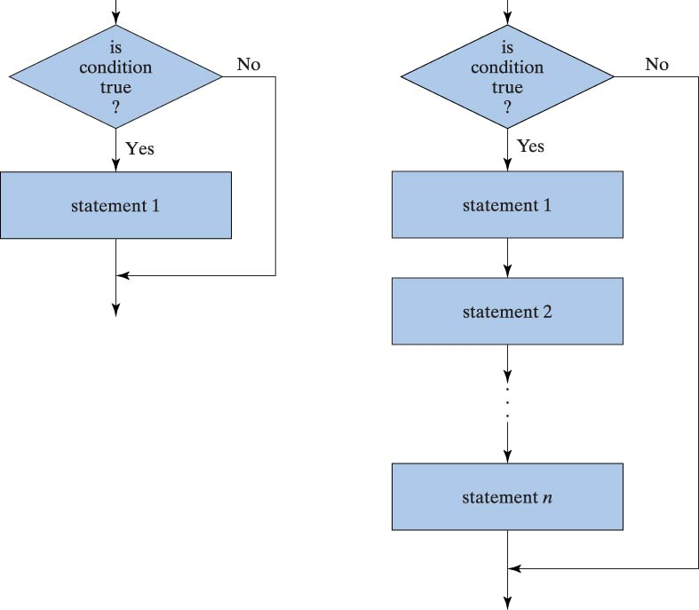
Flowcharts for Selection Statements
Etter/Ingber PSH/JKL

Slide 8
If statement
Used to allow some code to be skipped or alternate code executed depending on the condition.
A boolean expression (true or false) is evaluated at run-time using relational operators.
If (condition is true)
execute code;
If (condition is true)
{
execute many lines of code;
this one too;
}
Etter/Ingber PSH/JKL

Slide 9
If statement - examples
single statement
    if (x>0)
    k++;
    if(x>0)
    {
    x=sqrt(x);
    k++;
    }
compound (block) statement
Etter/Ingber PSH/JKL

Slide 10
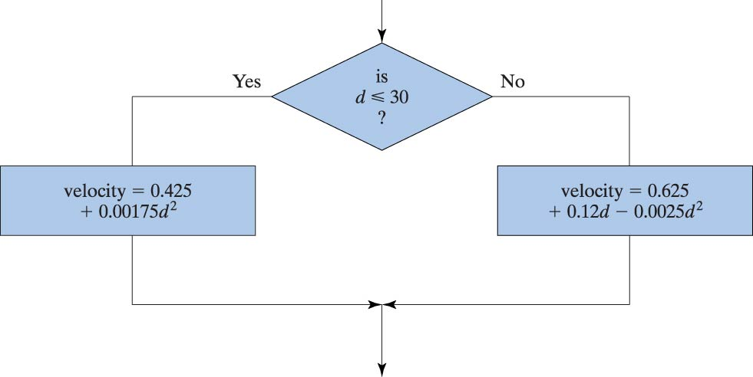
Flowchart for if/else Statement
If (d <= 30)
velocity = 0.425 + 0.00175 * d * d;
else
velocity = 0.625 + 0.12 * d - 0.0025 * d * d;
Etter/Ingber PSH/JKL

Slide 11
if - else statement
if(Boolean expression is true)
statement;
else
statement;
if(Boolean expression is true)
{
statement1;
statement2;
}
else
{
statement3;
statement4;
}
single statements
compound statements
Etter/Ingber PSH/JKL

Slide 12
nested if-else
Note that braces { } are not required here, but make the code easier to read.
if(x > y)
if(y < z)
k++;
else
m++;
else
j++;
if(x > y)
{
if(y < z)
k++;
else
m++;
}
else
j++;
Etter/Ingber PSH/JKL

Slide 13
nested if-else
Note that braces { } and indentation are not needed for single statements, but they should be used to make the code easier to read.
if(x > y)
{
if(y < z)
{
k++;
}
else
{
m++;
}
}
else
{
j++;
}
if(x > y)
if(y < z)
k++;
else
m++;
else
j++;
j++ means add 1 to j
Etter/Ingber PSH/JKL

Slide 14
Conditional Expressions

Slide 15
Conditional Expressions
Conditional expressions are important because both selection and repetition structures use conditions.
A condition is an expression that can be evaluated to be true or false.
It is composed of expressions combined with relational operators and logical operators.
Etter/Ingber PSH/JKL

Slide 16
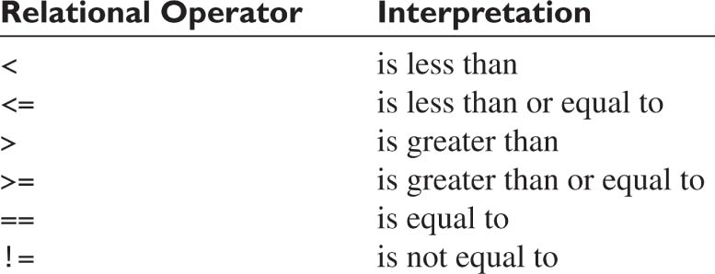
Relational Operators
Etter/Ingber PSH/JKL

Slide 17
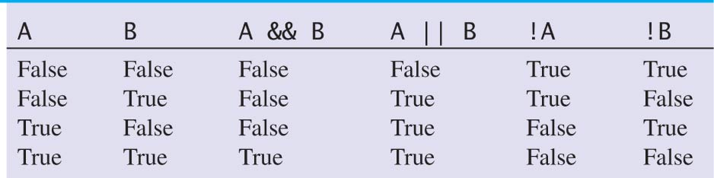
Logical Operators
Etter/Ingber PSH/JKL

Slide 18
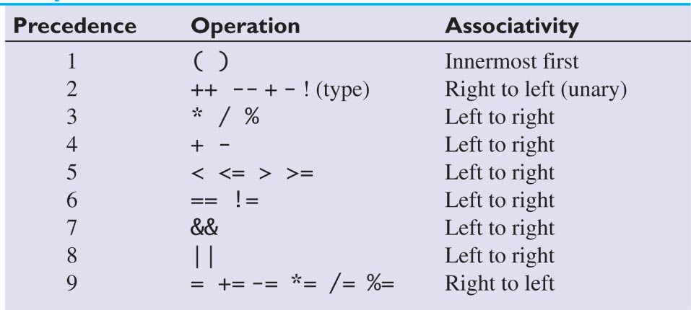
Precedence for Arithmetic, Relational, and Logical Operators
Etter/Ingber PSH/JKL

Slide 19
Practice!
int a = 9, b = 7, c = 2,
k = 0, m = 0, j = 0;
if(a > b)
if(b < c)
k++;
else
m++;
else
j++;
m++;
What are the values of j, k and m?
Etter/Ingber PSH/JKL

Slide 20
Practice!
int a = 9, b = 7, c = 2,
k = 0, m = 0, j = 0;
if(a > b)
{
if(b < c)
k++;
else
m++;
}
else
j++;
m++;
What are the values of j, k and m?
Etter/Ingber PSH/JKL

Slide 21
Another problem
A payroll system is required to calculate an employee’s pay, based on the hourly rate and the hours worked. The system should print out the employee’s name, the hours worked and the calculated wage.
For each week worked the program should accept an input of hours worked.
Employees working more than 40 hours receive overtime pay (1.5 times the normal rate) for the additional hours.
To prevent overtime abuse, if an employee has worked more than 30 hours of overtime in the past two weeks, a warning message is printed.
How would you solve this problem?
Etter/Ingber PSH/JKL

Slide 22
Payroll System Solution
if (hours <= 40)
weeklyPay = payRate * hours;
else
weeklyPay = 40 * payRate + ((hours - 40) * payRate * 1.5);
/*mixed math? */
if (hours <= 40)
currentOvertime = 0;
else
currentOvertime = hours - 40;
if ( (currentOvertime + overtimeHoursLastWeek) > 30) {
System.out.println(employeeName + " worked > 30 hrs overtime");
}
Etter/Ingber PSH/JKL

Slide 23
Write a nested if/else statement
Write a nested if/else statement for the following: Output an appropriate message about the person’s ability to drive a car for each outcome.
Ask for a person’s age
If the person is under 16, print “You may not drive”.
If the person is over 16 and less than 18, print “You need a licensed person”
If the person is between 18 and 21, print “You need a probationary license.”
If the person are 21 or over, print “you may drive a car”
Etter/Ingber PSH/JKL

Slide 24
Switch Statement
  switch(expression)
  {
case constant:
statement(s);
break;
case constant:
statement(s);
break;
/* default is optional*/
default:
statement(s);
  }
Etter/Ingber PSH/JKL

Slide 25
Switch Statement
char op_code = ‘M’;
switch (op_code)
{
case ‘N’: case ‘n’:
printf(“Normal operating mode\n”);
break;
case ‘M’: case ‘m’:
printf(“Maintenance needed\n”);
break;
default:
printf(“Error in code value”);}
}
char op_code = ‘M’;
if (op_code == ‘N’ || op_code ==‘n’)
printf(“Normal operating mode\n”);
else
if (op_code == ‘M’ || op_code ==‘m’)
printf(“Maintenance Needed\n”);
else
printf(“Error in code value”);
Etter/Ingber PSH/JKL

Slide 26
Switch Statement
Expression must be of type integer or character.
The keyword case must be followed by a constant.
break statement is required unless you want all subsequent statements to be executed.
Etter/Ingber PSH/JKL

Slide 27
Practice!
  Convert the following switch statements to a nested if/else statement:
switch (rank)
{
case 1: case 2:
printf(“Lower division\n”);
break;
case 3: case 4:
printf(“Upper division\n”);
break;
case 5:
printf(“Graduate student\n”);
break;
default:
printf(“Invalid rank”);
}
Etter/Ingber PSH/JKL

